Slide 1
Memory Allocation
Subject : COMP6047
ALGORITHM AND PROGRAMMING
Year : 2015

Slide 2
Learning Outcomes
At the end of this session, student will be able to:
Demonstrate usage of static and dynamic memory allocation in a C program (LO2 & LO3)

Slide 3
Sub Topics
Memory Allocation:
Static variable
Register variable
External variable
Void * data type
Command Line Argument
Command Execution
Memory Concept
Memory Allocation
Static Memory Allocation
Dynamic Memory Allocation
Macro
Pointer to Function
C Preprocessor

Slide 4
Static Keyword
Keyword static can be used as variable type, or return value type of a function
Static variable:
Allocated at program start and de-allocated at the end of a program
Default value = 0
Scope of static variable is inside a file where the variable is defined
Syntax:
static type variable_name;
Example:
static int x;

Slide 5
Static Keyword
Example of the static keyword:
static int i; //Variable accessible only from this file
static void func(); // Function accessible only from this
// file
int max_so_far( int curr ){
static int biggest; // Variable whose value is
// retained between each function
// call
if( curr > biggest ) biggest = curr;
return biggest;
}

Slide 6
Static Variable
Example:
#include <stdio.h>
void print()
{
static int count=0;
printf("count=%d\n",count++);
}
int main(void)
{
int i;
for(i=0; i<5; i++) print();
for(i=0; i<3; i++) print();
return 0;
}
Output:
count = 0
count = 1
count = 2
count = 3
count = 4
count = 5
count = 7

Slide 7
Register Variable
Objective: increase run time speed.
Defining a variable store in a register (if possible – register is limited). If rejected: automatic variable.
Syntax:
register data_type variable_name;
Example :
register int x;

Slide 8
External Variable
In a modular programming, a program is divided into modules. In C modules are implemented using function.
A module may consist of several functions. And save in a file.
If function in a particular file wants to access a variable in other file, then use keyword extern
Example :
extern int x;

Slide 9
External Variable
Example:
#include <stdio.h>
int main()
{
extern int x;
printf("%d\n",x);
return 0;
}
int x=12;
File: data.c
File : main.c

Slide 10
External Variable
Example: (Error)
#include <stdio.h>
int main()
{
extern int x;
printf("%d\n",x);
return 0;
}
static int x=12;
File: data.c
Error!
File : main.c
Scope of a static variable is the file where it is defined.

Slide 11
Void * Data Type
Keyword void :
void main(void)
{
void *malloc(size_t size);
………
}
Function without actual parameter
Pointer that can point any data type
A void function

Slide 12
Void * Data Type
Type void * always use type casting
Example:
char *pstr;
int *pint;
float *pfloat;
pstr=(char *)malloc(20);
pint=(int *)malloc(20);
pfloat=(float *)malloc(20);

Slide 13
Const Char *
Comparing char * with const char * using strcpy
Example:
char *strcpy( char *strDestination, const char *strSource );
Description:
char * : should be a pointer (has an address)
const char * : can be string or pointer
Example:
char ss[20]; char str[20] = ”Good Morning”;
strcpy(ss,”Good Morning”);
strcpy(ss, str);
strcpy(”Hello”, ss); //error
Constant String

Slide 14
Command Line Argument
Some time application should take input parameters from the command line: DOS, Linux e.g.:
copy file1 file2
del file3
How to get parameters: file1, file2 and file3?
Answer: Adding parameters on the main program
int main( int argc, char *argv[ ])

Slide 15
Command Line Argument
Example:
#include <stdio.h>
int main( int argc, char *argv[ ]) {
int i;
printf(“Total argument=%d\n",argc);
for(i=0; i<argc; i++) {
printf("Argument %d = %s\n",i,argv[i]);
}
return 0;
}
If the above code run from DOS command or LINUX console will result:
C>Prog argc1 argc2 argc3
Argument 0 = Prog
Argument 1 = argc1
Argument 2 = argc2
Argument 3 = argc3

Slide 16
Command Execution
To execute DOS or LINUX command, we can use library function system(char *)
Example:
#include <stdio.h>
int main(){
char str[]=“Welcome to BINUS\n";
printf(str);
system("date");
return 0;
}
Output:
Welcome to BINUS
The current date is: 08/07/2007
Enter the new date: (dd-mm-yy)

Slide 17
Memory Allocation
Memory allocation:
acquiring some memory space (RAM) managed by the OS to be used by a program.
Memory de-allocation:
releasing memory space (RAM) back to the OS.
int main() {
long nim;
float gpa;
...
}
nim is a variable, nim needs memory space as data store.
gpa is a variable, gpa needs memory as data store

Slide 18
Memory Allocation
Memory Allocation as a data store:
1. static
 can be assigned with name → variable
 allocated at compile time
 stored at local stack memory
 remain unchanged during the program run
 de-allocated when the program end
2. dynamic
 can be assigned with name
 allocated at run-time
 stored at heap memory
 can be de-allocated at any time

Slide 19
Static Memory Allocation
struct tdata {
char nim[9];
char name[26];
float gpa;
} ;
int main () {
struct tdata data[100];
int i;
...
}
If an integer needs memory space of 4 bytes and a float 8 bytes then variable data and i above need memory space of:
100 x (9 + 26 + 8) + 4 = 4504 byte

Slide 20
Dynamic Memory Allocation
Function malloc() is used to allocate one block of memory dynamically at heap memory. An argument (actual parameter) sent to this function is a value stating the size of allocated memory (in byte)
Syntax :
void * malloc (size_t size);
size: size of memory in byte.
If allocation is successful, it will return memory address of the memory allocated. If not (e.a: proposed malloc size larger than existing heap memory), it will return Null.
Example:
int *a;
a = (int *) malloc(sizeof(int));

Slide 21
Dynamic Memory Allocation
Function calloc() is used to allocate some blocks of memory dynamically at heap memory, where each element given size. Calloc initialized all elements with zero.
Syntax :
void *calloc(size_t memblock, size_t size);
size = number of byte ea block or element
memblock = number of block or element
Example:
int *a;
a = (int *) calloc(20,sizeof(int));

Slide 22
Dynamic Memory Allocation
Function realloc() is used to reallocate some blocks of memory or element dynamically at heap.
Syntax :
void *realloc(void *ptr, size_t size);
size = number of byte each block or element
ptr = is a pointer to the address of targeted memory location.
Example:
int *a, *ptr;
a = (int *) realloc(ptr,sizeof(int));

Slide 23
Dynamic Memory Allocation
Function free() used to release allocated memory at heap memory.
Syntax: void free (void *block);
block is a pointer to a memory location (dynamic)
# include <stdio.h>
# include <stdlib.h>
int main() {
int *number1, *number2, *number3;
number1 = (int *) malloc (sizeof(int));
number2 = (int *) malloc (sizeof(int));
number3 = (int *) malloc (sizeof(int));
scanf("%d %d", number1, number2);
*number3 = *number1 * *number2;
printf("%d x %d = %d\n", *number1, *number2, *number3);
free(number1); free(number2); free(number3);
return 1;
}

Slide 24
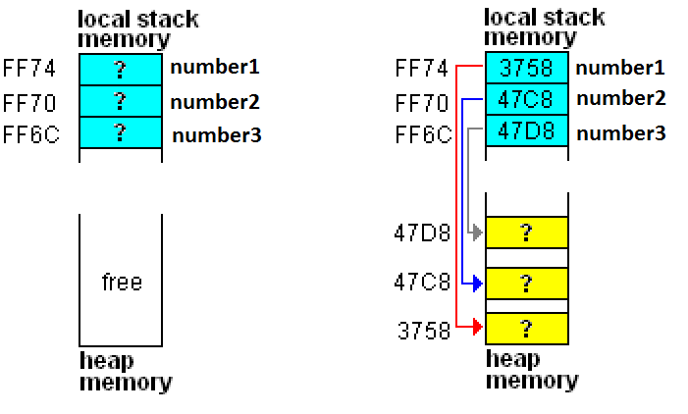
Integer Memory Allocation
int *number1, *number2, *number3;
number1 = (int *) malloc (sizeof(int));
number2 = (int *) malloc (sizeof(int));
number3 = (int *) malloc (sizeof(int));

Slide 25
Array Memory Allocation
# include <stdio.h>
# include <stdlib.h>
int main() {
int *arr, n, i;
do {
fflush(stdin);
printf(“total element ? ");
scanf("%d", &n);
if (n == 0) break;
arr = (int *) malloc (n * sizeof(int));
printf(“Input %d numbers: ", n);
for (i = 0; i < n; i++) scanf(“%d", &arr[i]);
printf(“reversed: ");
for (i = n - 1; i >= 0; i--) printf("%d ", arr[i]);
printf("\n\n");
free(arr);
}while (1);
return 1;
}

Slide 26
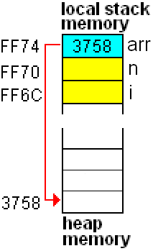
Array Dynamic Memory Allocation
int *arr;
printf(“total element ? ");
scanf("%d", &n);
arr = (int *) malloc (n * sizeof(int));
total element ? 3

Slide 27
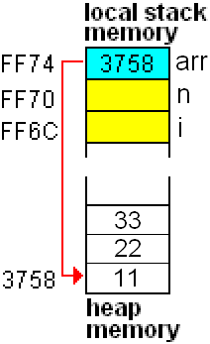
Array Dynamic Memory Allocation
printf(“Input %d numbers: ", n);
for (i = 0; i < n; i++) scanf("%d", &arr[i]);
printf(“reversed: ");
for (i = n - 1; i >= 0; i--) printf("%d ", arr[i]);
total element ? 3
Input 3 numbers: 11 22 33
reversed: 33 22 11

Slide 28
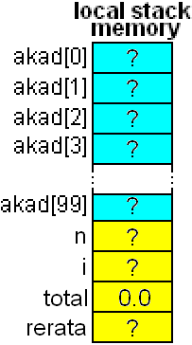
Array of Pointer of Dynamic Structure
# include <stdio.h>
# include <stdlib.h>
struct takad {
char nim[9];
float gpa;
} ;
int main() {
struct takad *akad[100];
int n, i;
float total = 0, rerata;
...
}

Slide 29
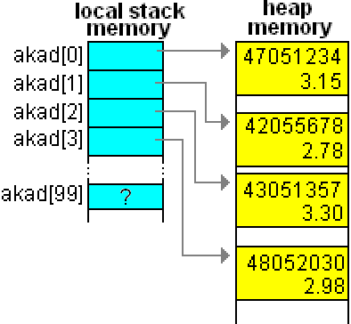
Array of Pointer of Dynamic Structure
akad[i]= (struct takad*) malloc(sizeof(struct takad));

Slide 30
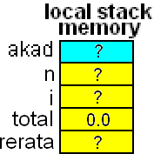
Pointer of Array of Dynamic Structure
# include <stdio.h>
# include <stdlib.h>
struct takad {
char nim[9];
float gpa;
} ;
int main() {
struct takad *akad;
int n, i;
float total = 0, rerata;

Slide 31
Macro
Using #define
Placed at the beginning of a code
Its scope starts at its declaration position to the end of a program.
A macro is not recognized by other program.
#include <stdio.h>
#define ERROR printf("Error..\n")
int main() {
int x=0;
int y=35;
if(x == 0) ERROR;
else y=y/x;
return 1;
}

Slide 32
Macro
Example using Parameter
#include <stdio.h>
#define SUM(x, y)(x+y)
int main() {
int x=10;
int y=35;
printf("%d\n",SUM(x,y));
return 1;
}

Slide 33
Pointer to Functions
Pointer to function is the address of a function in the memory
Syntax:
return_type (* pointer_name)(parameter);
Example:
int (*compare)(int a, int b);
note: compare is pointer to function name, pointing to a function that return integer value which has 2 integer parameters
Note the difference:
int compare (int a, int b);
Means: compare is a function name with integer return value that has 2 integer parameters

Slide 34
Pointer to Functions
Example:
#include <stdio.h>
int function1(int a);
int function2(int b);
int main()
{
int x;
int(*f)(int);
f=function1;
x=(*f)(3);
printf("x=%d\n",x);
f=function2;
x=(*f)(13);
printf("x=%d\n",x);
getch();
return(0);
}
int function1(int a)
{
a++;
return a;
}
int function2(int b)
{
b = b * b;
return b;
}

Slide 35
C Preprocessor Directive
Process is done before compilation.
Preprocessor directive started with symbol #
Example :
Preprocessor #define also used for macro
#include <filename>
#include ”namafile”
#define identifer replacement-text
Example:
#define PHI 3.14
Discussed at session 3-4

Slide 36
C Preprocessor Directive
Conditional Compilation
#if expression
……
#endif
OR
#if expression
……
#else
……
#endif
Preprocessor operator defined :
Syntax :
defined( identifier )
defined identifier
Return true (nonzero) if identifier has been defined and false (0) if not.

Slide 37
C Preprocessor Directive
#include <stdio.h>
#include <stdlib.h>
#define DEVC
int main()
{
int i;
for(i=1; i<79; i++){
gotoxy(i,10); printf(" =>");
#if defined TURBOC
delay(60);
#else
sleep(60);
#endif
}
getch();
return 0;
}
Dev-C does not have delay() as in Turbo C, but using sleep() instead.
To write a code compliable to both compiler, then this preprocessor example can be used.
This program is to be compiled inDev-C

Slide 38
C Preprocessor Directive
#include <stdio.h>
#include <stdlib.h>
#define TURBOC
int main()
{
int i;
for(i=1; i<79; i++){
gotoxy(i,10); printf(" =>");
#if defined TURBOC
delay(60);
#else
sleep(60);
#endif
}
getch();
return 0;
}
This program is to be compiled in Turbo-C

Slide 39
Exercise
Using <malloc.h> describe the following function!
void *malloc ( size_t size );
void *calloc ( size_t num, size_t size );
void *realloc ( void *memblock, size_t size );
void free ( void *memblock );
void (*ptr[3])(int)= {function1. function2, function3};
Describe the above code!

Slide 40
Exercise
Describe the following preprocessor directive:
1. #ifdef
……
#endif
2. #error
3. #pragma
4. #line
5. #ifndef
……
#endif

Slide 41
Exercise
C language provides the following predefined symbolic constant:
__LINE__
__FILE__
__DATE__
__TIME__
Describe each symbolic constant above!
Describe the pro-cons of using macro along with a function!

Slide 42
Summary
Memory allocation:
acquiring some memory space (RAM) managed by the OS to be used by a program
Memory de-allocation:
releasing memory space (RAM) back to the OS

Slide 43
References
Paul J. Dietel,Harvey M. Deitel,. 2010. C : how to program. PEAPH. New Jersey. ISBN:978-0-13-705966-9 Chapter 2, 13 & 14
C - Storage Classes: http://www.tutorialspoint.com/cprogramming/c_storage_classes.htm
C Programming - Dynamic Memory allocation: http://www.exforsys.com/tutorials/c-language/dynamic-memory-allocation-in-c.html

Slide 44
END

